Slide 1
Operation Analytics and investigating metric spike
A project on advanced sql

Slide 2
Description
Operational Analytics is the process to understand and work on the end to end data of a company for different purposes such as evaluation, identifying problems and solutions etc.
Investigating metric spike is a part of analytics which helps in understanding and explaining changes in key aspects such as sales, engagement etc.
We have used MySQL to complete this project.
We have worked with provided data sets and sample data set to understand and learn different metrics.

Slide 3
Process
We have 4 data sets- job data( sample data), users, events and email events.
Firstly we created the database OA_AND_IMS.
Then we created first table i.e. job_data, inserted given data set into the table and then filled the table with another 100 random data points to understand and work with it.
Then we created other 3 tables i.e. users, events and email_events and inserted given data sets into the tables.
Then we wrote different queries on MySQL for different problems.

Slide 4
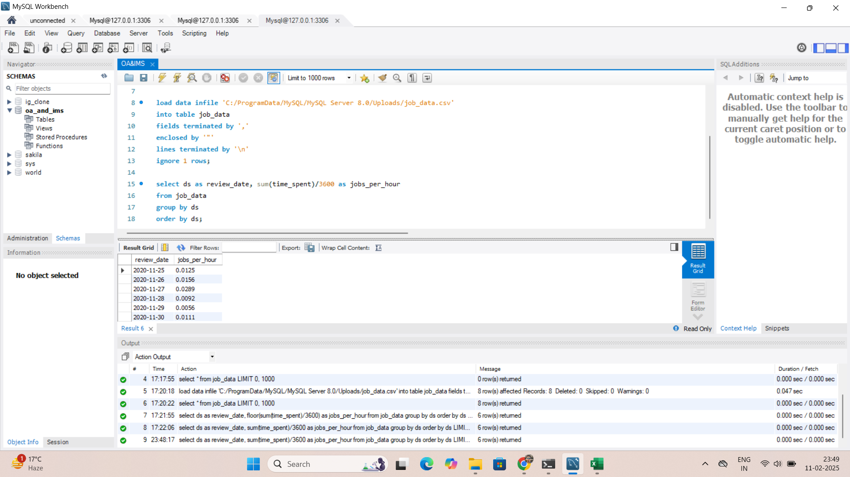
Insertion of data
SYNTAX-
Load data infile ‘File Path’
Into table Table1
Fields terminated by ‘,’
Enclosed by ‘”’
Lines terminated by ‘\n’
Ignore 1 rows;
EXPLAINATION-
After creating the database and
table, we load provided data set
into the table using load data infile.
We provided ‘ , ‘ to differentiate
column names.
For new lines \n is used.
Ignore 1 rows is used to ignore the
the first row which is header.

Slide 5
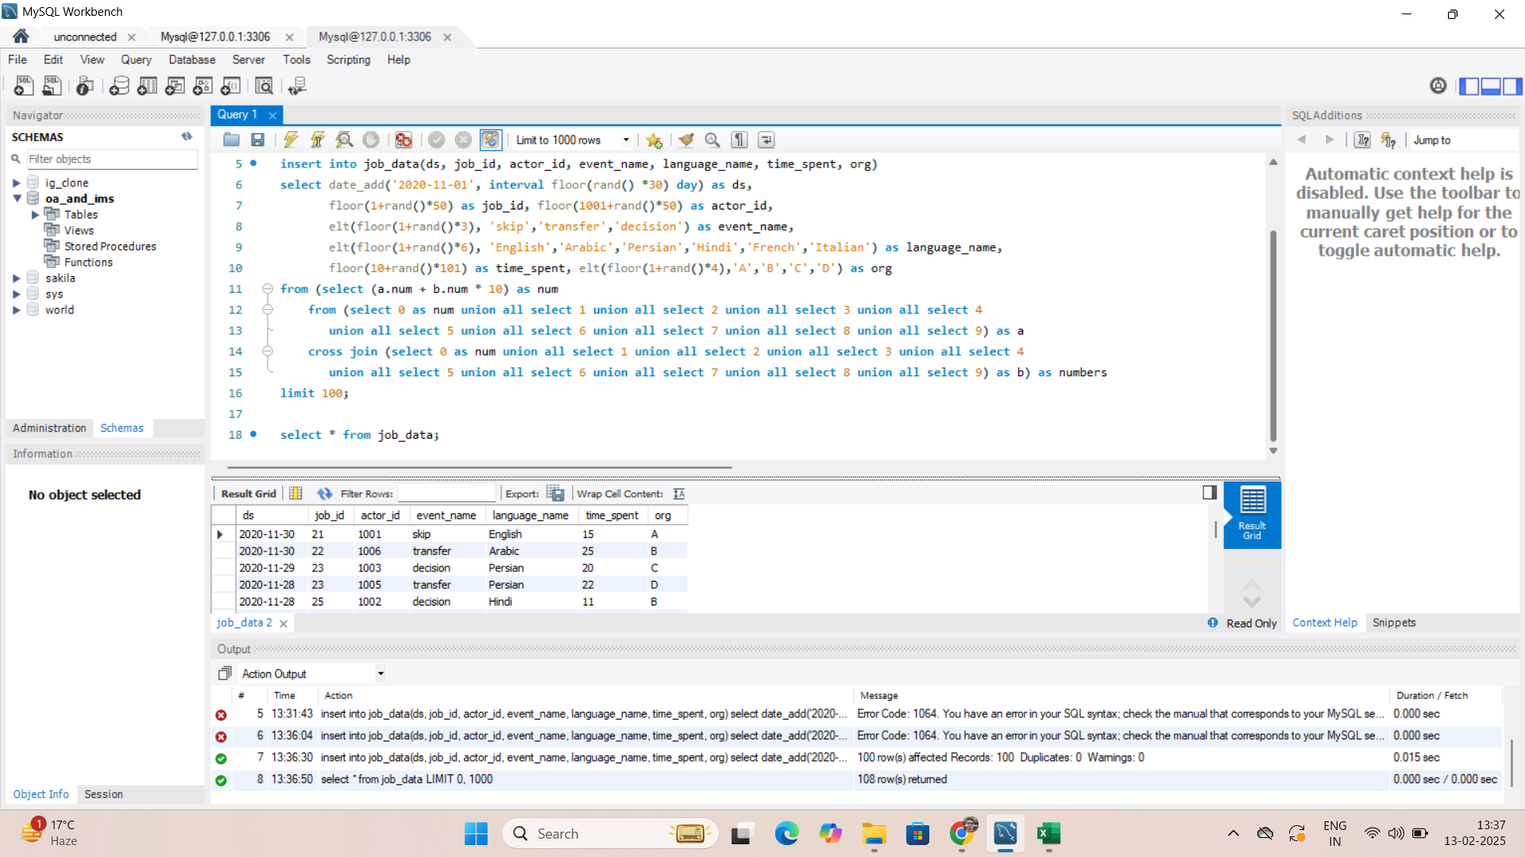
Case study 1- job data analysis create table with random data
EXPLAINATION-
Inserted random data in all columns.
Kept different data types and used Rand to fill with desired data.
Used Union two times to get 10*10 rows, total 100.

Slide 6
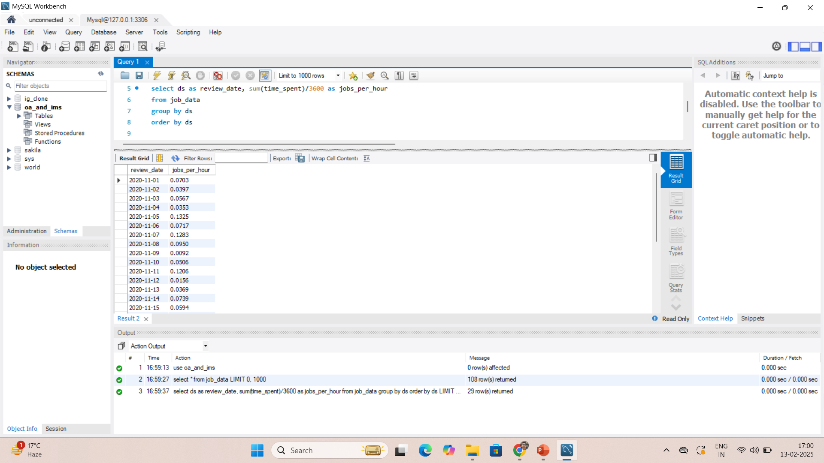
Jobs reviewed over time
EXPLAINATION-
Selected review date and calculated total time spent / 3600 i.e. per hour.
Grouped and ordered it by review date.

Slide 7
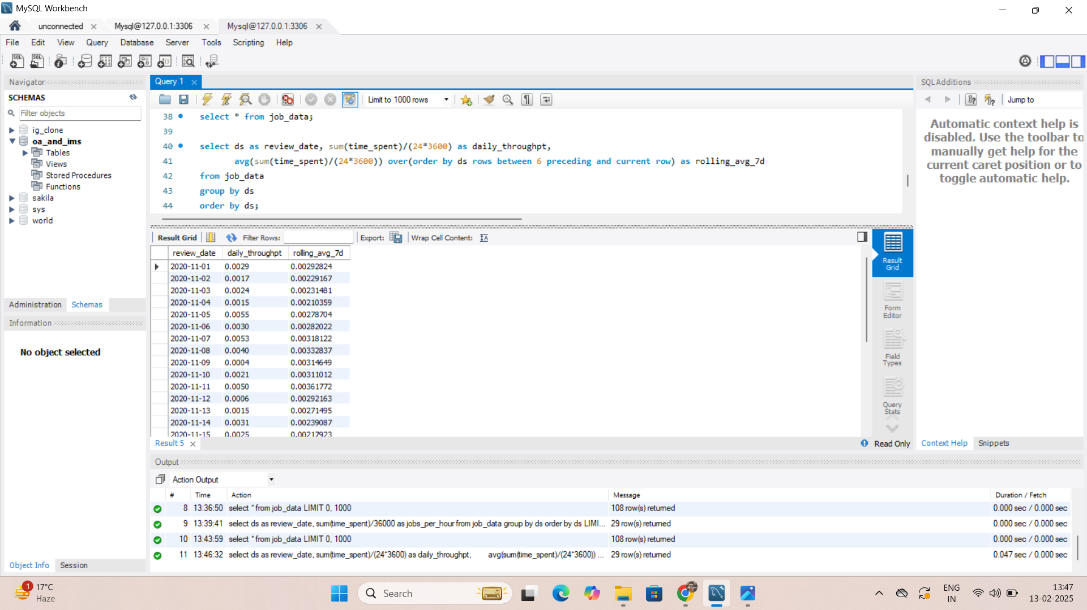
Throughput analysis
EXPLAINATION-
Selected review date, calculated total time spent per day( total time spent/( 24*3600)) and weekly rolling average i.e. weekly average calculated every day continuously.
I would prefer rolling average over daily metric as rolling average smooths out the result while daily metric might have high fluctuations.

Slide 8
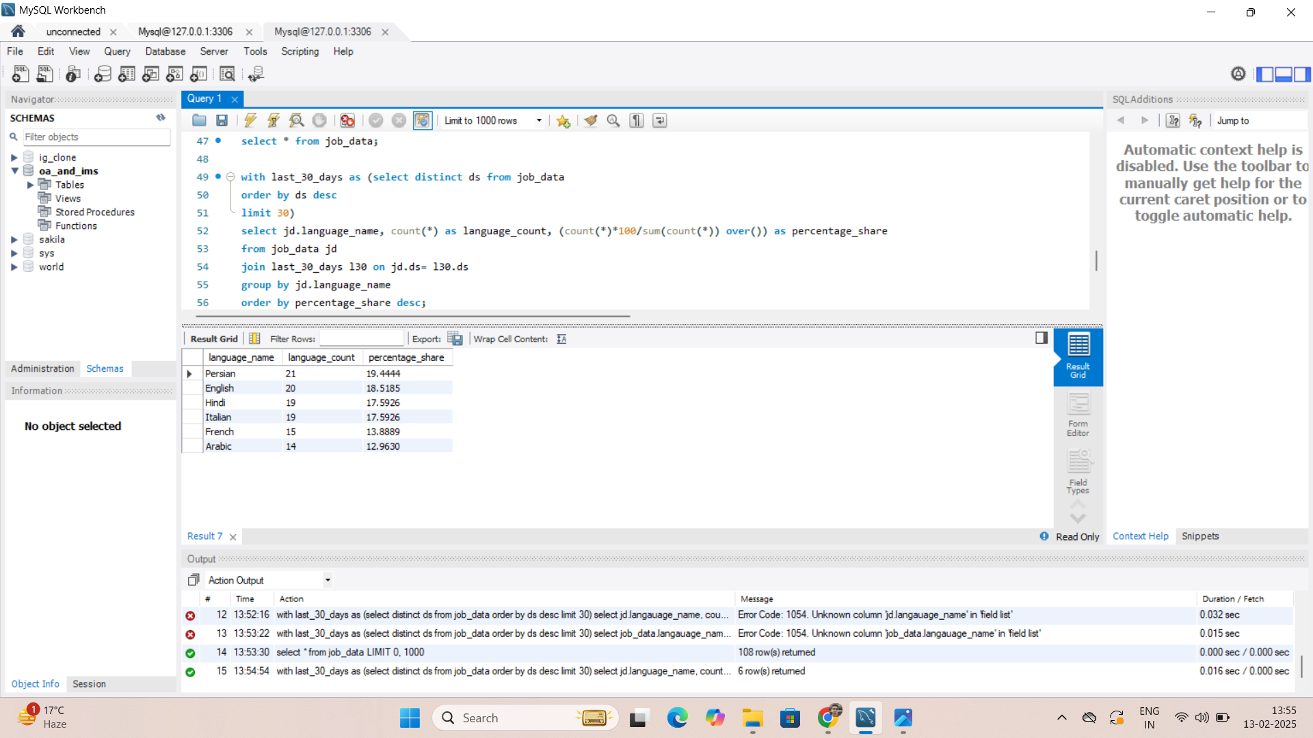
Language share analysis
EXPLAINATION-
Selected language name, total count of every language name being appeared and percentage share of all the language.
Joined it with distinct review date to get unique last 30 days result.
Grouped it by language name.

Slide 9
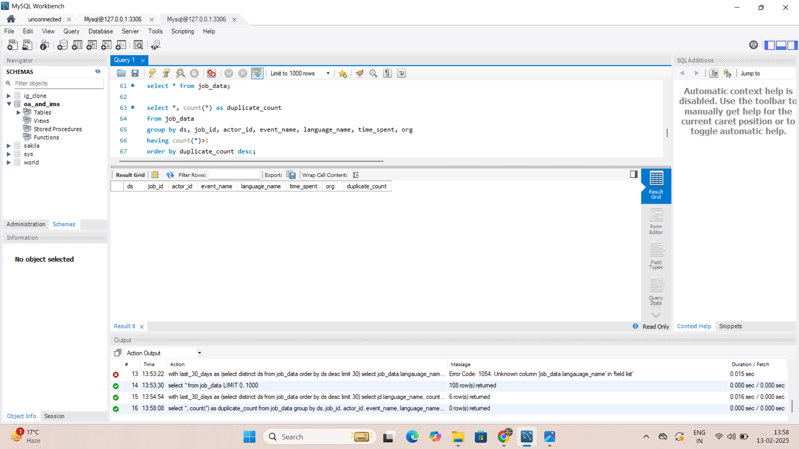
Duplicate rows detection
EXPLAINATION-
Selected all columns and total counts of all column data.
Grouped it by all columns so it gives the result where all the data points are same in different rows.
Having >1 to get results more than one such row.
The result is nill which shows there is no duplicate rows.

Slide 10
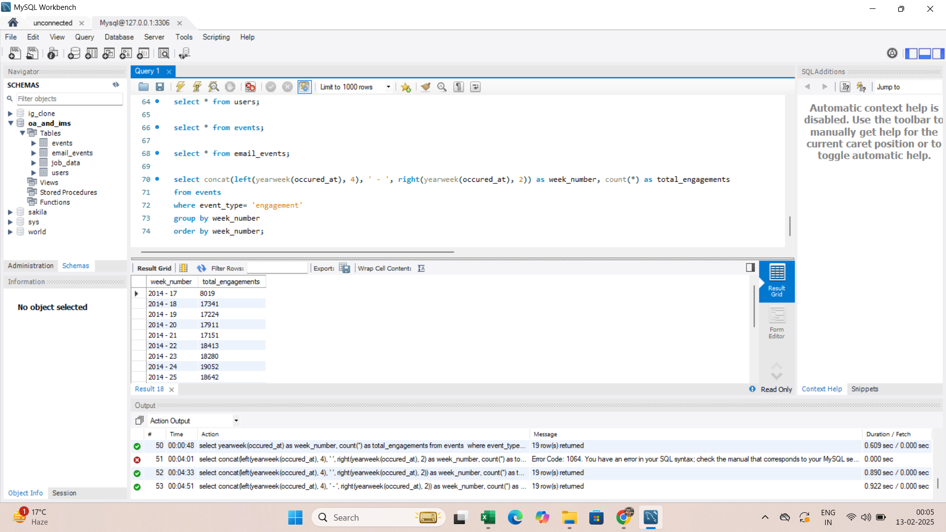
Cas study 2-investigating metric spike weekly user engagement
EXPLAINATION-
Selected year number and week number and total count of all events which are engagement.
Grouped and ordered it by week number to get total engagements of every week.

Slide 11
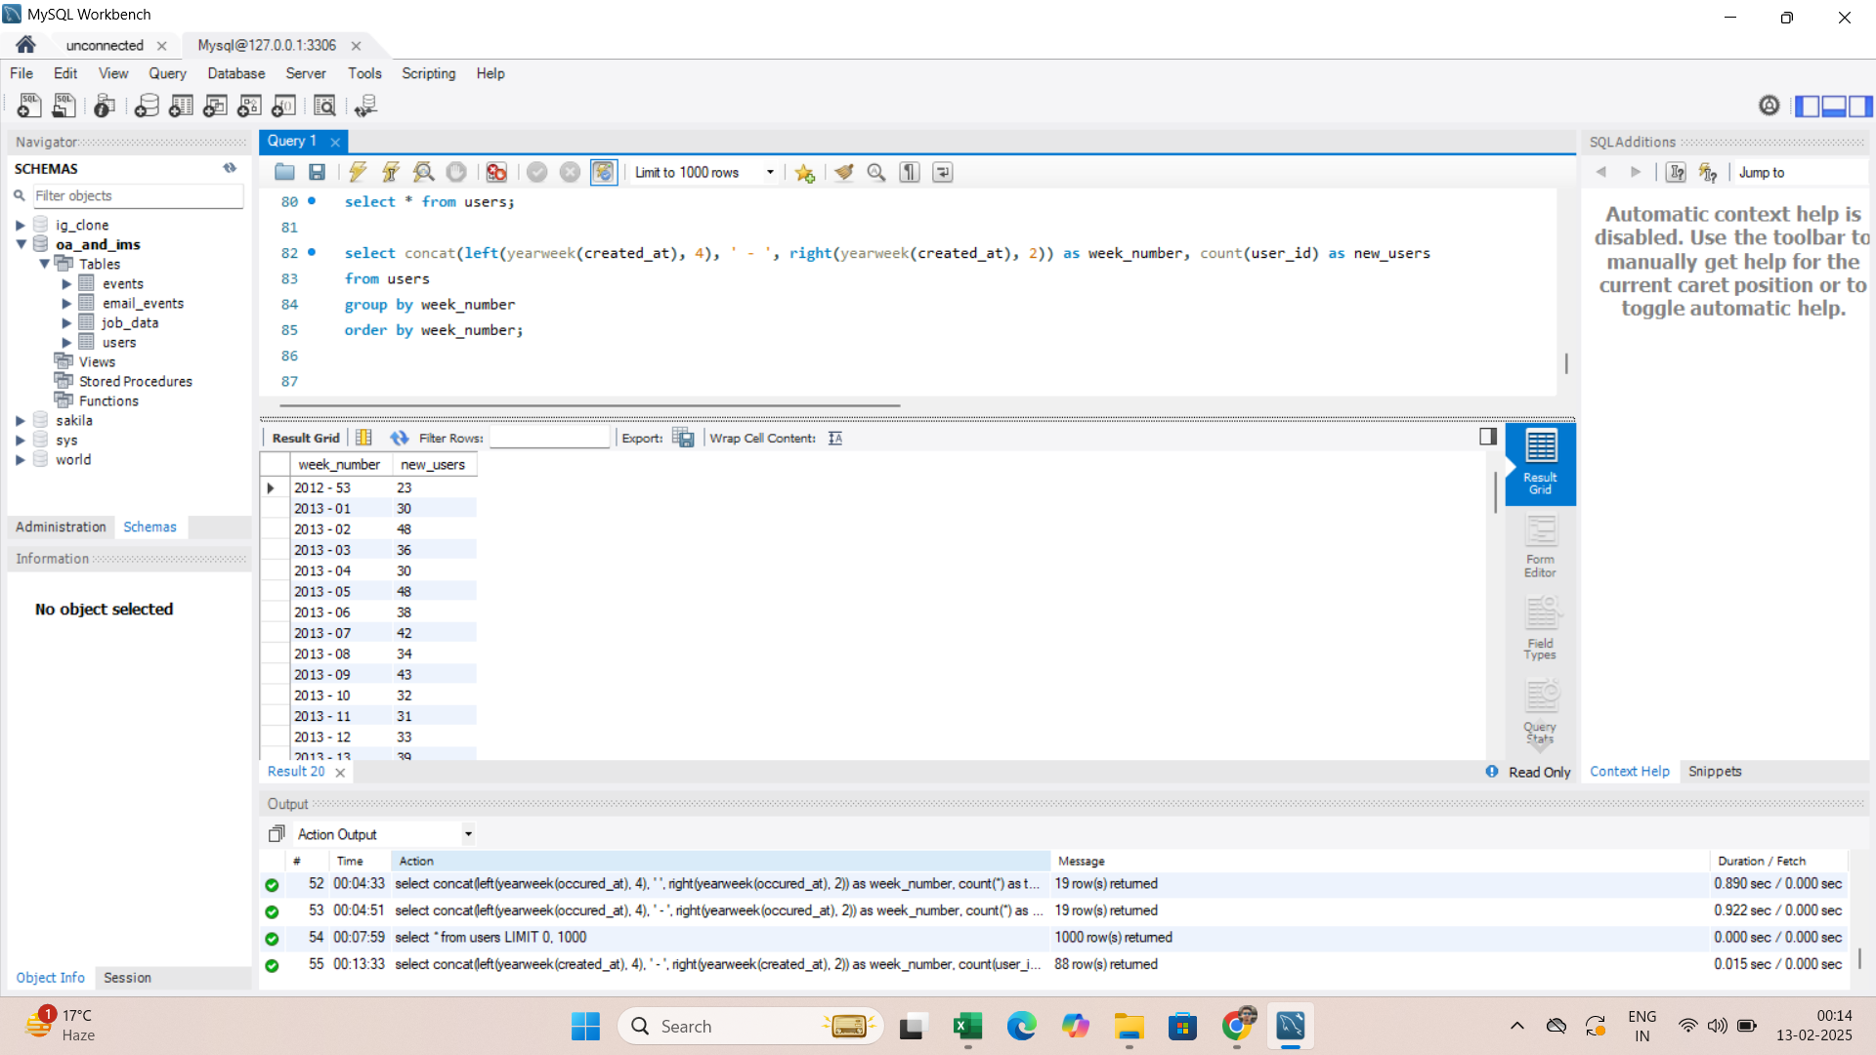
User growth analysis
EXPLAINATION-
Selected year and week number on which account is created and calculated total count of all user ids.
Grouped and ordered it by week number to get new users registered every week.

Slide 12
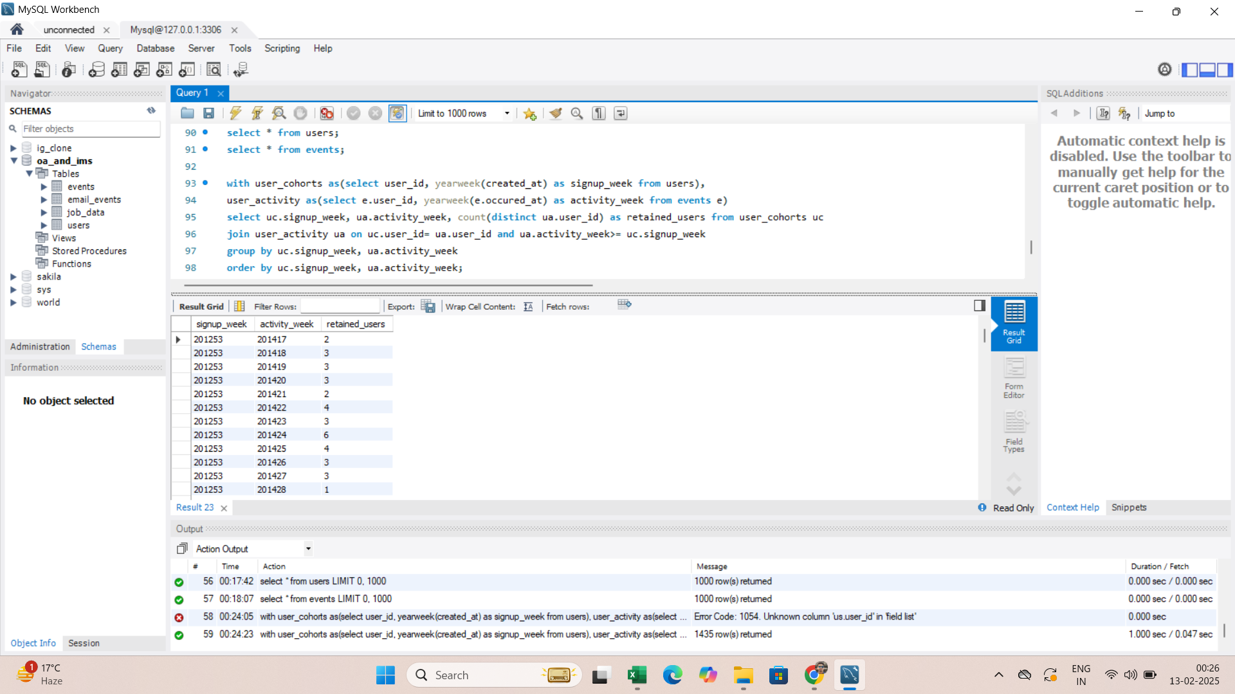
Weekly retention analysis
EXPLAINATION-
Selected variables made with id creation date and event occurrence date and calculated total count of user ids and joined both variables.
Grouped and ordered it by signup and activity week to get total user ids which are active each week.

Slide 13
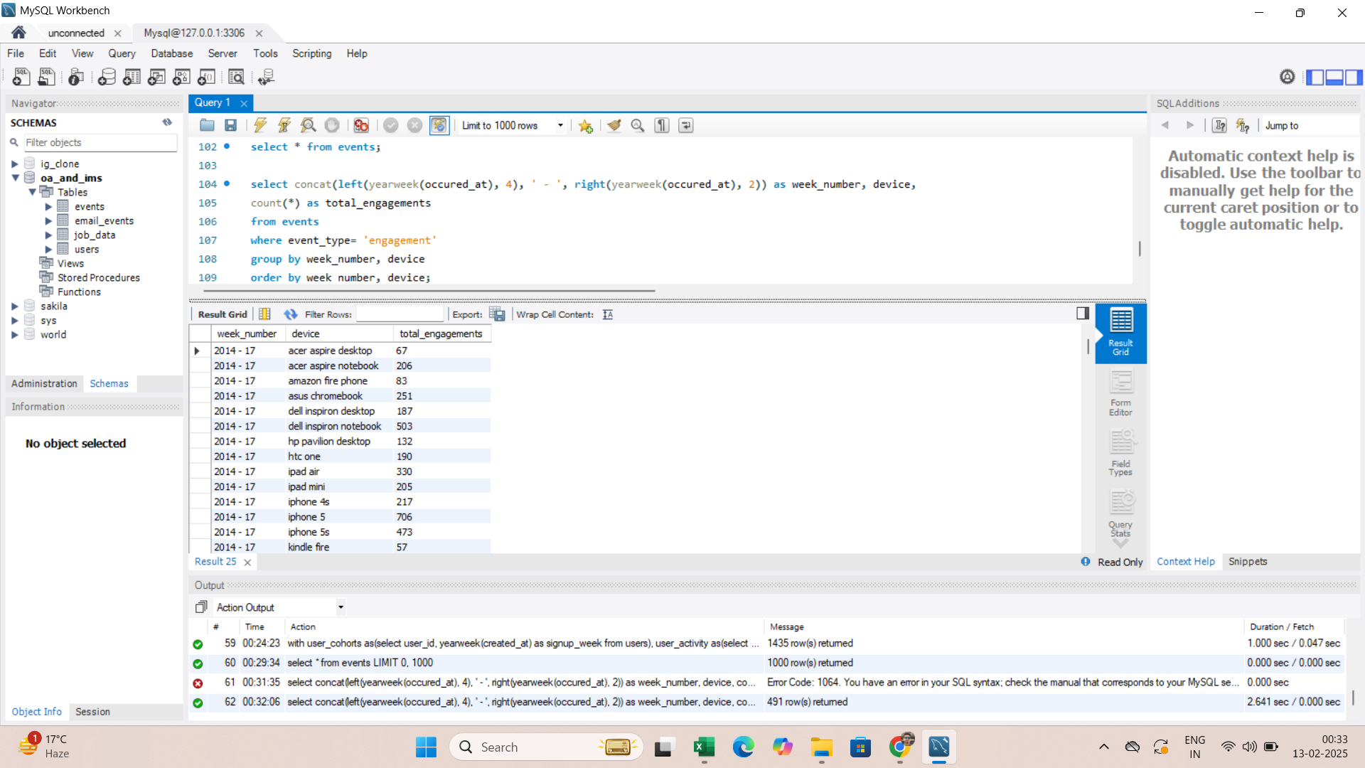
Weekly engagement per device
EXPLAINATION-
Selected year and week number, devices and total count of all event type as engagement.
Grouped and ordered it by week number and device to get total engagement per device.

Slide 14
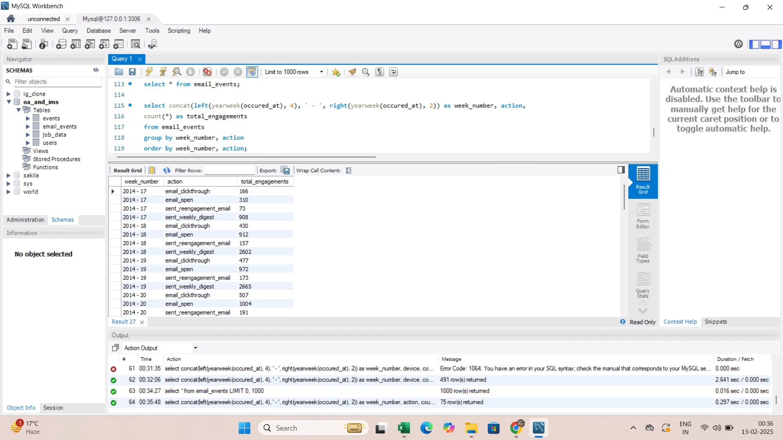
Email engagement analysis
EXPLAINATION-
Selected year and week number of occurrence of any email event, action and total count of email engagements.
Grouped and ordered it by week number and action to get total count of every type of email event.

Slide 15
Thank you
BY-
ALANKAR SAXENA

